Slide 1

IPWAVE Basic Protocols Project @ IETF-108 Hackathon
Installation & Manual
Champion: Jaehoon Paul Jeong pauljeong@skku.edu
Sungkyunkwan University
IETF 108, Online July 20, 2020

Slide 2
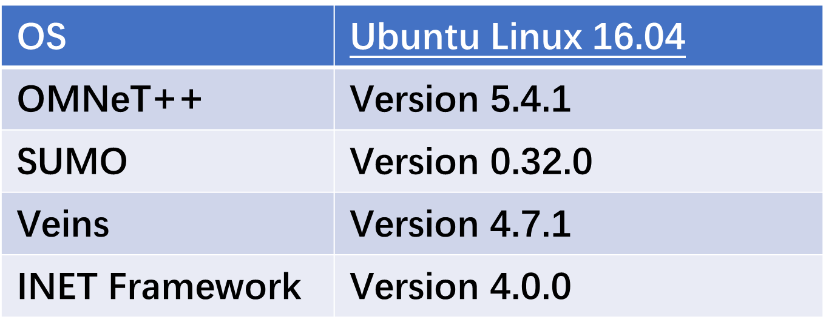
Hackathon Development Environment

Slide 3
Install OMNeT++ Version: 5.4.1 for Linux

Slide 4
Install OMNeT++ Version: 5.4.1 for Linux
1) Download Version 5.4.1 on https://www.omnetpp.org/omnetpp
2) Please refer to Chapter 5.3.1 in document below to install the Prerequisite Libraries required before the installation.
https://www.omnetpp.org/doc/omnetpp/InstallGuide.pdf
The contents in the above document can be run as follows:
Please run the red-line commands line by line. (you can directly copy the lines in pdf file.)

Slide 5
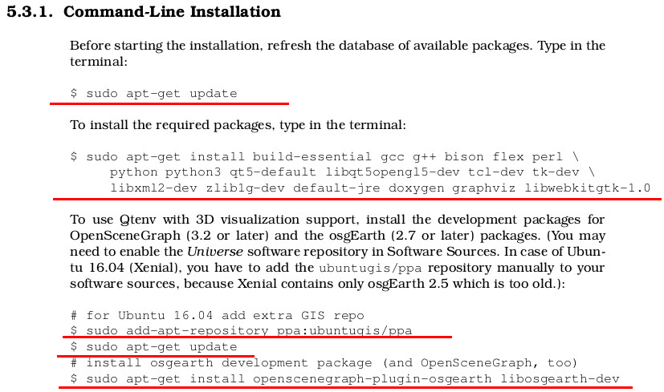

Slide 6
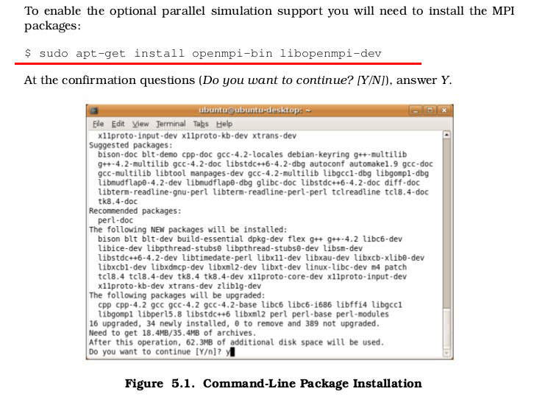

Slide 7
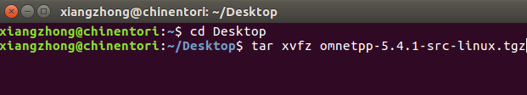
3) Unpacking
Open the folder of installation package.
$cd YOUR PATH
Unpack the installation package.
$ tar xvfz omnetpp-5.4.1-src-linux.tgz

Slide 8
4) To set the environment variables permanently, edit .bashrc in your home directory.
Use your favourite text editor to edit .bashrc, for example, sublime text.
$ subl ~/.bashrc

Slide 9
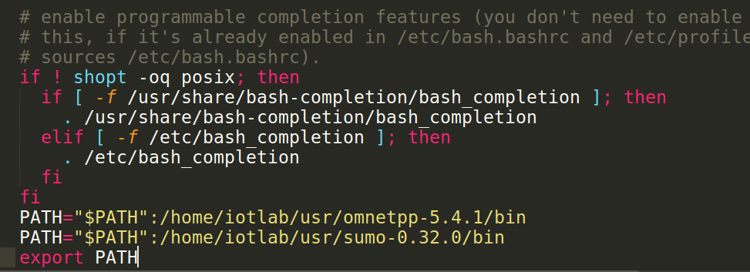
5) Add the following line at the end of the file, and then save it (change the path according to yours).
export PATH=$PATH:/home/iotlab/usr/omnetpp-5.4.1/bin
You need to close and reopen the terminal for the changes to take effect.

Slide 10
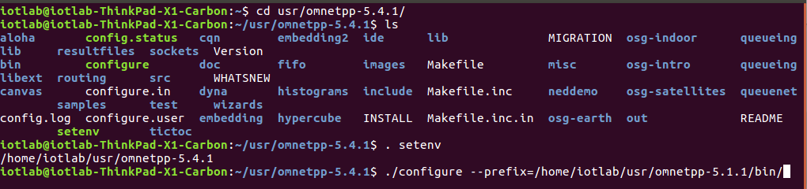
6) In the top-level OMNeT++ directory, type the following command:
$ ./configure
If you see “Your PATH contains /YOUR PATH/, Good!”, then you can continue the next step.

Slide 11
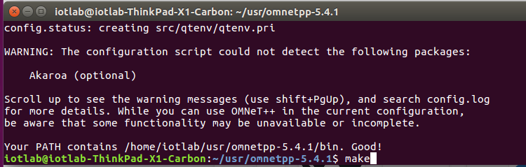
7) $ make (It may take over 10 minutes)
If you see “Now you can type “omnetpp” to start the IDE”, then you have succeeded in installing OMNeT++.
8) Type “omnetpp” to start the IDE:

Slide 12
Install SUMO Version: 0.32.0

Slide 13
Install Required Packages
$ sudo apt-get install autoconf
$ sudo apt-get install libproj-dev proj-bin proj-data libtool libgdal1-dev libxerces-c3-dev libfox-1.6-0 libfox-1.6-dev python-dev python3-dev

Slide 14
Configure & Make
Download source code on https://github.com/ipwave-hackathon-ietf
Go to sumo-0.32.0 folder
$ ./configure --prefix=the path of the current folder (e.g., /home/iotlab/usr/ipwave-hackathon-ietf/sumo-0.32.0)
$ make
(in case of multicore (e.g., 4), to speed compiling,
use: make -j 4)
When the make is finished, run ./bin/sumo, it shall show version information:

Slide 15
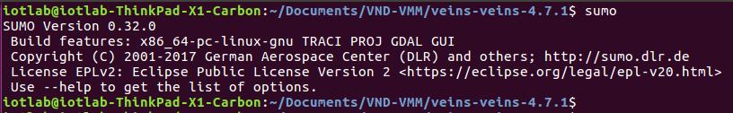
Check Installed SUMO Version

Slide 16
Import IPWAVE Basic Protocols Project

Slide 17
1) Run the sumo launched file in veins folder first to ensure the connection to SUMO when you run Veins in OMNeT++.
$ sumo-launchd.py -v -c /home/chris/usr/sumo-0.32.0/bin/sumo-gui

Slide 18
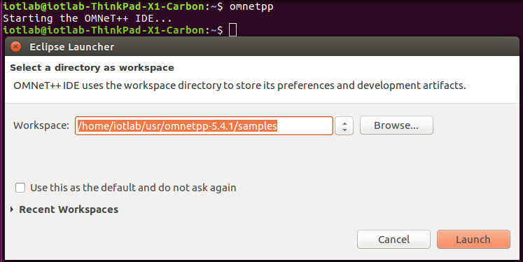
2) Open a new terminal, enter the path where omnetpp installed, and run omnetpp.

Slide 19
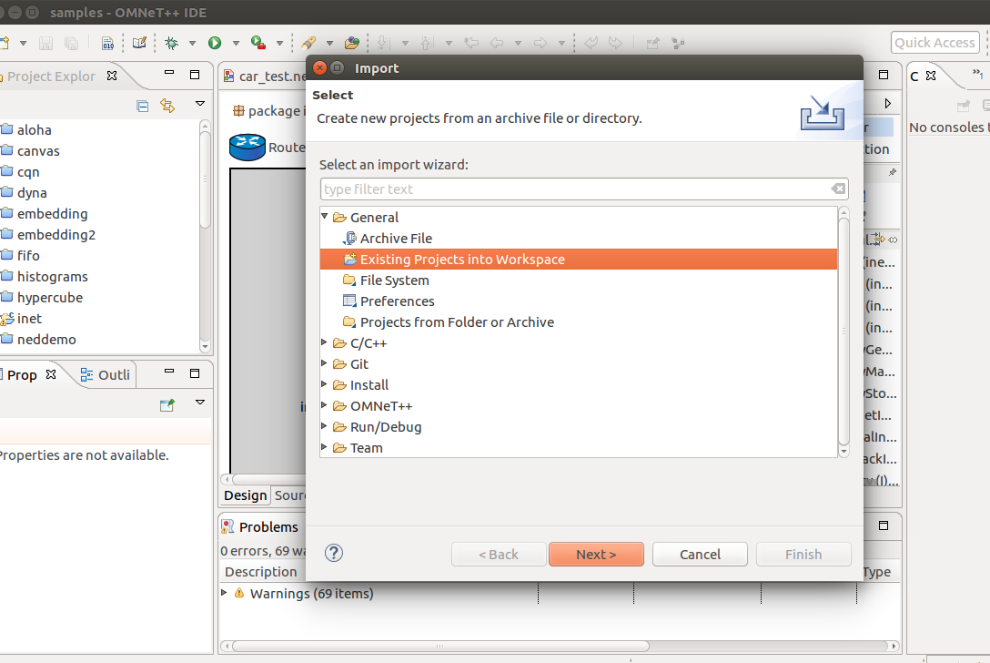
3) Import
Click File -> Import -> Existing Projects into Workspace ->Next -> Browse -> Choose the folder of veins -> Finished

Slide 20
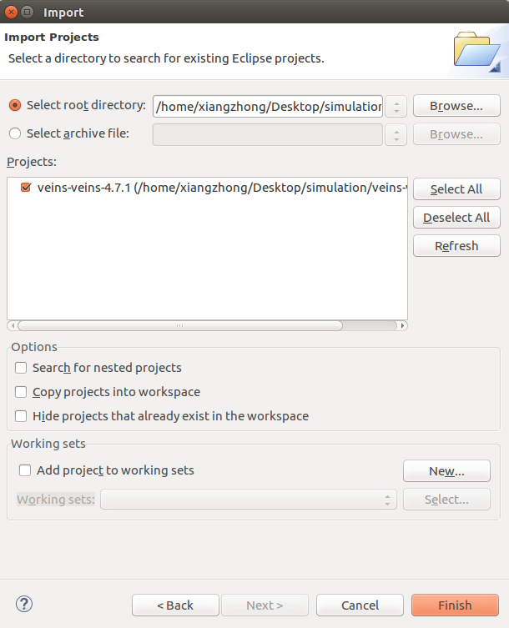
4) Select root directory of your Veins project, and then click Finish.
5) In the same way, import inet project to the workspace.

Slide 21
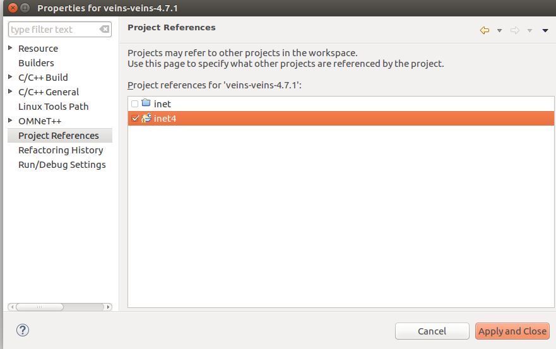
6) Now, you may see errors in veins. That may because the invalid reference folder.
To check the reference of inet to Veins, right-click Veins project in the Project Explorer, click Properties. Then choose Project References, click the right project in workspace, and cancel the click of the empty one.

Slide 22
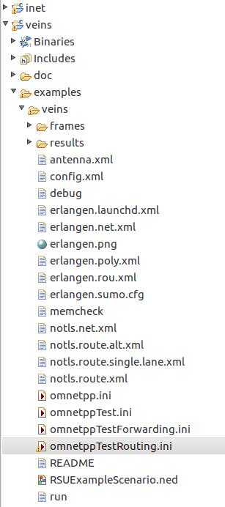
7) In Project Explorer, right-click Veins
project, and choose Build Project. It may
take several minutes.
8) In Project Explorer, find veins ->examples -> veins -> omnetppTestRouting.ini, and then right click it.
Choose Run As -> OMNeT++ Simulation. It
may take several minutes.

Slide 23
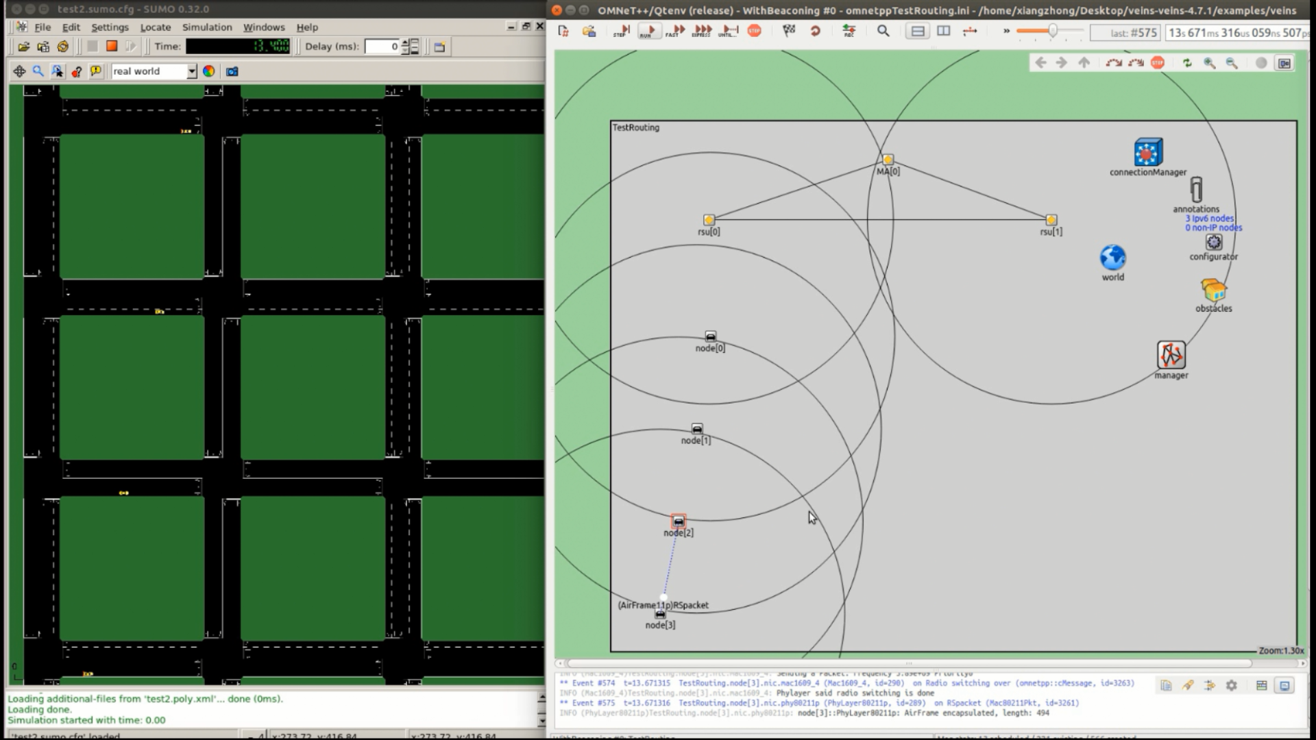
10) Click the Run button to run the program, and then you will see Sumo gui window.
(For test, we reduce the number of cars.)

Slide 24
Good Luck & Enjoy
If you have questions or comments, you can contact us:
Bien Aime Mugabarigira: bienaime@skku.edu
Yiwen Chris Shen: chrisshen@skku.edu
Ahn Yoseop: ahnjs124@skku.edu
Jaehoon Paul Jeong: pauljeong@skku.edu

